Slide 2

Saranya Sriram
Principal PM Lead, Azure Cosmos DB, Microsoft

Slide 3

Enterprise Security Features on Azure Cosmos DB
Saranya Sriram
@sharan779

Slide 4
Azure Cosmos DB Security – Overall Model
Azure Cosmos DB Security – Auth
Agenda
Azure Cosmos DB Security – Encryption
Azure Cosmos DB Security via Diagnostics
Azure Cosmos DB Security related communications
Links and Resources

Slide 5





Azure Cosmos DB
Core (NoSQL) API
MongoDB
Table API
Postgres API
Column-family
Document
Key-value
Graph
Guaranteed low latency at the 99th percentile
Relational
Elastic scale out
of storage & throughput
Five well-defined consistency models
Turnkey global distribution
Comprehensive SLAs

Slide 6
What is Cosmos DB : Database for Modern Applications
Today : Operational Needs​
High throughput ingestion of both batch & streaming feeds with real-time indexing​
Global distribution with active-active setup​
Apps to perform real-time CRUD & queries using developer friendly NoSQL APIs​
No downtime elastic scaling of database​
SLAs for latency/availability/consistency/throughput
Cosmos DB = Above +
Globally distributed
Multiple Model
Multi Master
Lowest Latency for read/write
Developer friendly
Auto Indexed ; AutoScale
Ring Zero
NoSQL LOB Apps
Enterprise Grade Security principals
Data Security including BYOK

Slide 7
Azure Cosmos DB Security: Overall

Slide 8
Your Security Team Extended
Microsoft
CDOC
Azure
Security
Cosmos DB
Security
Your
Security

Slide 9
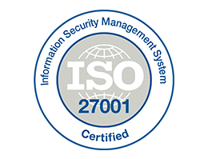



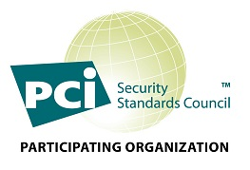

Microsoft CDOC - Compliance
Datacenter security overview - Microsoft Service Assurance | Microsoft Learn
GA for 1+ Years
Presence in 54+ Azure Regions, including Sovereign Clouds
Will be in all Azure Data Centers
Certifications & Attestations:
ISO 9001, 27001 & 27018
SOC 1 Type 1, SOC 1 Type 2, SOC 3
EU Model Clauses
HIPAA
PCI-DSS
FedRAMP [Medium + High]
HITRUST
Certifications & Attestations in Progress:
DoD DISA SRG Level 4, 5
Find the latest certifications here - https://gallery.technet.microsoft.com/Overview-of-Azure-c1be3942

Slide 10
Azure Security Foundation
Foundation of common controls:
All products follow the Security Development Lifecycle (SDL).
All production is access via dedicated secure access workstations (SAWs).
All production access requires Just In Time (JIT) approval.
All production access is monitored.
All production deployments require multiple approvals including test sign off and approvers.
All products run a common security agent to collect anomalous activity.
All production resources are patched regularly.
All secrets / certificates / passwords have defined lifetimes and required rotations.
All production ports are scanned, and penetration tested regularly.
All source code is scanned looking for security issues.
All source code requires two approvers to check in.
All teams do breach drills.

Slide 11
Overall Security model for Cosmos DB
Azure Cosmos DB is secure by design:
Your security team extended
Azure Security Foundation
Network Security
Web security (CORS)
Authorization
Global Replication
Local Replication
Backups
Monitoring for Attacks
Encryption at rest
Compliance
Azure Security Baseline for Cosmos DB .
Notes:
The Azure Security Baseline for Cosmos DB contains recommendations that will help you improve the security posture of your deployment.
The baseline for this service is drawn from the Azure Security Benchmark version 1.0, which provides recommendations on how you can secure your cloud solutions on Azure with our best practices guidance.
For more information, see Azure Security Baseline for Cosmos DB .

Slide 12
Note Worthy Features
ARM control of database and collections
Detailed monitoring logs for ARM actions
Data only access with addition of disableKeyBasedMetadataWriteAccess (doc page)
TLS 1.2 Enforcement by Account Option
Customer Managed Keys
Encryption at rest available by default for new and existing collectiond
Always Encrypted and Client-Side encryption : Private Preview
AAD RBAC for Control plane and Data plane on Cosmos DB
Improvements in monitoring and telemetry
Data governance integration , Azure governance integration : Private Preview
Security integration for Azure Synapse analytical storage and link

Slide 13
Azure Cosmos DB Security: Network

Slide 14
Network Security
All connections are HTTPS/SSL/TLS 1.2 w/ Enforcement Option
Standard HTTPS verbs and semantics
Requests are logged and available in Azure Monitoring
HTTPs 404 responses are available in Azure Metrics
IP Firewalls
VNET
Service Endpoints
Service Link
Private Link (aka Private IP and Private Endpoints)
Notes:
Baseline for network security covers
Protect resources using Network Security Groups or Azure Firewall on your Virtual Network
Monitor and log the configuration and traffic of Vnets, Subnets, and NICs
Protect critical web applications
Deny communications with known malicious IP addresses
Record network packets and flow logs
Deploy network based intrusion detection/intrusion prevention systems (IDS/IPS)
Manage traffic to web applications
Minimize complexity and administrative overhead of network security rules
Maintain standard security configurations for network devices
Document traffic configuration rules
Use automated tools to monitor network resource configurations and detect changes
See detail in https://docs.microsoft.com/en-us/azure/cosmos-db/security-baseline#network-security
Additional Remark #1. You can also reduce the risk of data exfiltration by configuring a strict set of outbound rules on a network security group (NSG) and associating that NSG with your subnet, with the following steps:
Create a network security group and security rules
Create a virtual network and associate a network security group to a subnet
Deploy Cosmos DB into a subnet
Test traffic filters

Slide 15
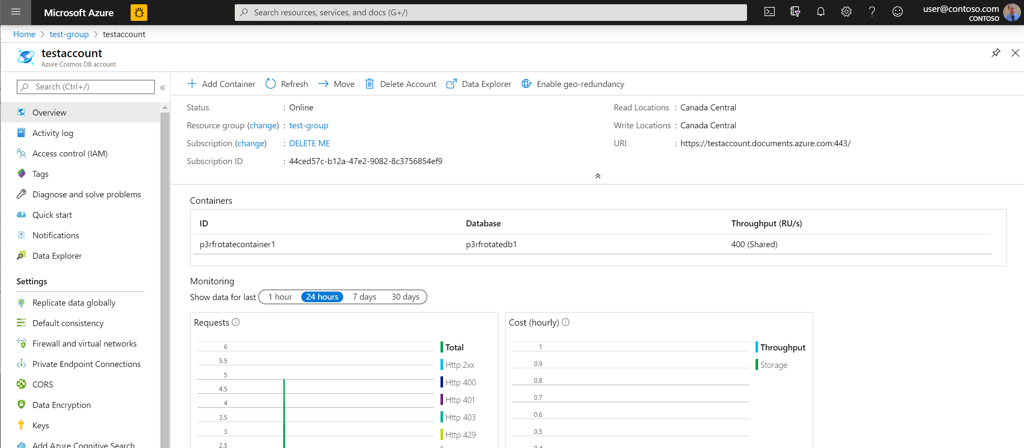
Network Security: IP Firewalls, vNETs, and Endpoints
Configure an IP firewall
Configure VNet
Configure Azure Private Link for an Azure Cosmos account
Notes:
You can secure the data stored in your Azure Cosmos DB account by using IP firewalls. Azure Cosmos DB supports IP-based access controls for inbound firewall support. You can set an IP firewall on the Azure Cosmos DB account by using one of the following ways:
From the Azure portal
Declaratively by using an Azure Resource Manager template
Programmatically through the Azure CLI or Azure PowerShell by updating the ipRangeFilter property
Azure Cosmos account can be configured to allow access only from a specific subnet of virtual network (VNet). By enabling Service endpoint to access Azure Cosmos DB on the subnet within a virtual network, the traffic from that subnet is sent to Azure Cosmos DB with the identity of the subnet and Virtual Network.
Once the Azure Cosmos DB service endpoint is enabled, you can limit access to the subnet by adding it to a Azure Cosmos account.
By using Azure Private Link, you can connect to an Azure Cosmos account via a private endpoint. The private endpoint is a set of private IP addresses in a subnet within your virtual network. You can then limit access to an Azure Cosmos account over private IP addresses. When Private Link is combined with restricted NSG policies, it helps reduce the risk of data exfiltration.

Slide 16
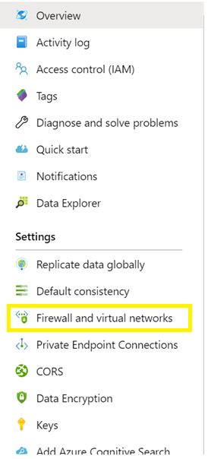
Network Security: IP Firewalls and vNETs
IP Firewalls
Multiple layers of protection for user data
Allow a specific IP 168.61.48.0
Allow an IP range 168.61.48.0/8
Allow combinations of IPs and ranges
Deny logs are available
vNets
Supports subnetting
Cosmos DB account appears in the vNET.
IP Firewalls and vNET work together.
Configure an IP firewall
Configure VNet

Slide 17
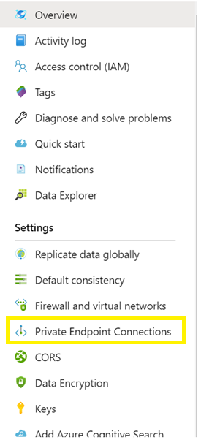
Network Security: Endpoints
Service Endpoints
Allows Azure Cosmos DB account in the vNET
Restricts access to the account from only the vNET
Public IP used for account access
Allows access to accounts not in a vNET
Private Endpoints
Places Azure Cosmos DB account in the vNET
Restricts access to the account from only the vNET
Assigns a private IP for the account
No access other accounts if public IPs are restricted.

Slide 18
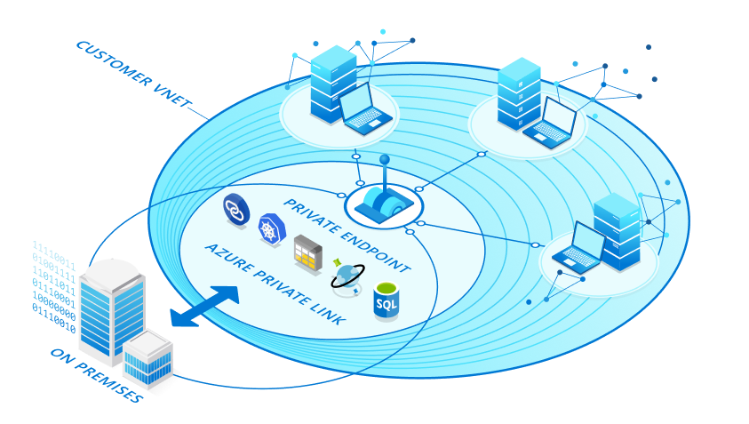
Network Security: Private Link / Private IP
Configure Azure Private Link for an Azure Cosmos account

Slide 19
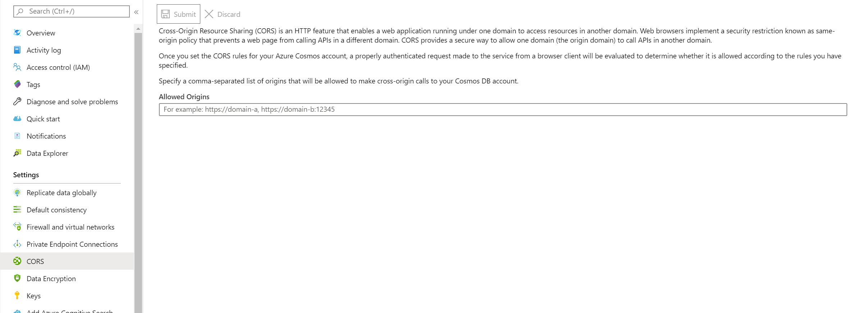
Web Security: CORS
CORS support allows web applications to directly call to Cosmos DB. Without CORS the browser will block the call.
Configure Cross-Origin Resource Sharing (CORS)
Notes:
Cross-Origin Resource Sharing (CORS) is an HTTP feature that enables a web application running under one domain to access resources in another domain. Web browsers implement a security restriction known as same-origin policy that prevents a web page from calling APIs in a different domain. However, CORS provides a secure way to allow the origin domain to call APIs in another domain. The Core (SQL) API in Azure Cosmos DB now supports Cross-Origin Resource Sharing (CORS) by using the “allowedOrigins” header. After you enable the CORS support for your Azure Cosmos account, only authenticated requests are evaluated to determine whether they are allowed according to the rules you have specified.

Slide 20
Azure Cosmos DB Security: Auth

Slide 21

Authorization
Azure Active Directory Integration at the Cosmos DB Account Level. This include operations and controls around firewalls, logging, and key access.
Master keys and Resource Tokens are used for data access. These control Read / Insert / Delete operations along with throughput control and collection creation.

Slide 22
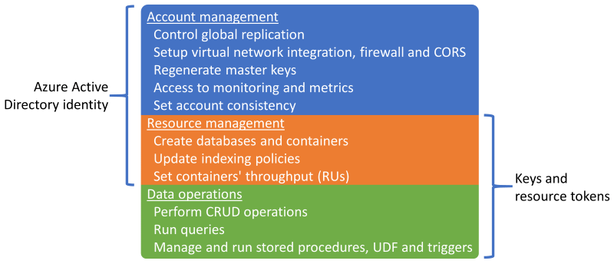
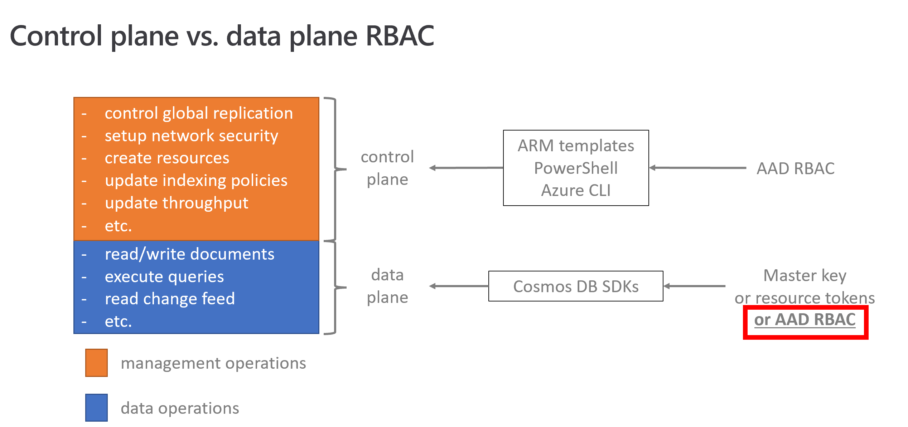
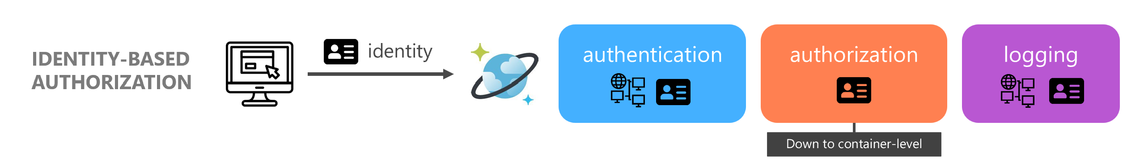
Authorization: How the Active Directory is moving toward the data

Slide 23
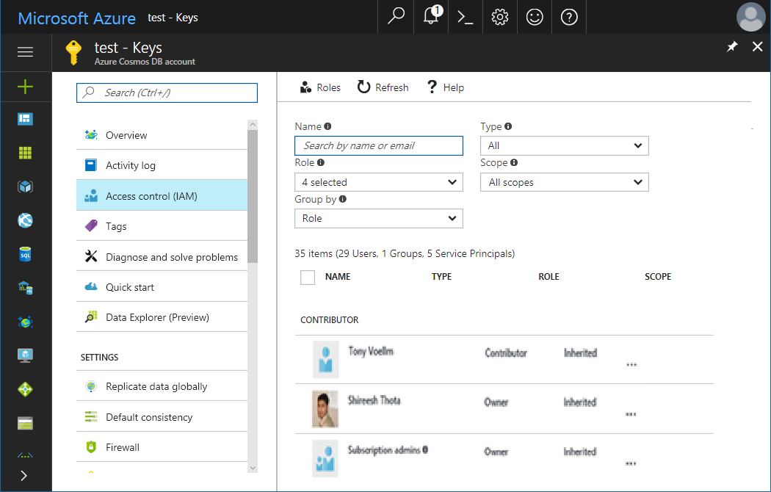
Identity and Access Management (IAM aka RBAC)
Access Control
Supports ActiveDirectory Integration
Handles Users and Groups
Controls access to database accounts via defined roles (Owner, Reader, Contributor, …)
Access
control
Notes:
Cosmos DB provides built-in role-based access control (RBAC) for common management scenarios in Azure Cosmos DB.
An individual who has a profile in Azure Active Directory can assign these RBAC roles to users, groups, service principals, or managed identities to grant or deny access to resources and operations on Azure Cosmos DB resources.
Role assignments are scoped to control-plane access only, which includes access to Azure Cosmos accounts, databases, containers, and offers (throughput).
The following are the built-in roles supported by Azure Cosmos DB
DocumentDB Accounts Contributor
Can manage Azure Cosmos DB accounts.
Cosmos DB Account Reader
Can read Azure Cosmos DB account data.
Cosmos Backup Operator
Can submit restore request for an Azure Cosmos database or a container.
Cosmos DB Operator
Can provision Azure Cosmos accounts, databases, and containers but cannot access the keys that are required to access the data.

Slide 24
Authorization: Master Key
Master key - a security token to access all resources for an account. Individuals with the key have full access including read and write access to the all resources in the database account.
All keys are created during the creation of an account, but can be regenerated and rotated at anytime.
Each account consists of 2 Master keys: Primary key and Secondary key
Account administrators have the ability to regenerate the keys as needed. For instructions, see How to manage a Cosmos DB account.
Use caution when distributing master keys. The primary master key and secondary master key are available in the Keys blade of the Azure Portal.

Slide 25
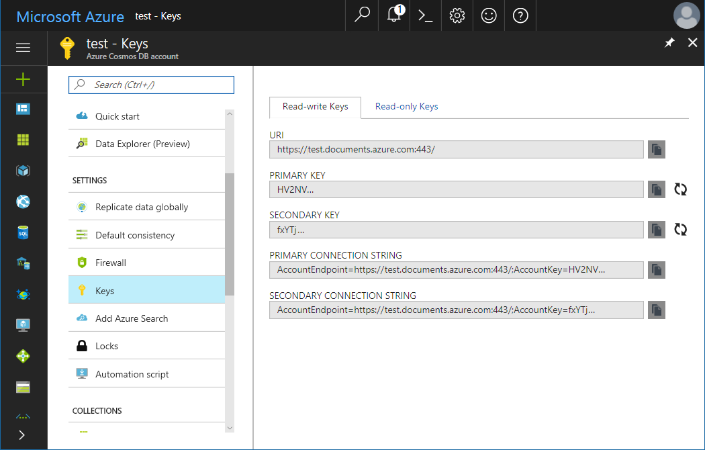
Authorization: View, copy and regenerate/rotate access keys
When you create a Cosmos DB account, the service generates two master access keys that can be used for authentication when Cosmos DB account is accessed. By providing two access keys, Cosmos DB enables you to regenerate/rotate the keys with no interruption to your Cosmos DB account.
View yours Keys from your Cosmos DB Account blade
Copy yours Uri + Keys from the Keys panel
Regenerate yours Keys from the Keys panel

Slide 26
Authorization Best practice: Regenerate/Rotate access keys
Periodically regenerate/rotate your Cosmos DB account access keys to keep your connections more secure.
Two master keys are assigned to each account to allow administrators to regenerate one key while the other maintains connections to the Cosmos DB account.
Recycling old master key
1
2
3
4
Navigate to Azure Portal
Retrieve your secondary key
Replace current primary key with secondary key
Rotate primary key in the Azure Portal

Slide 27
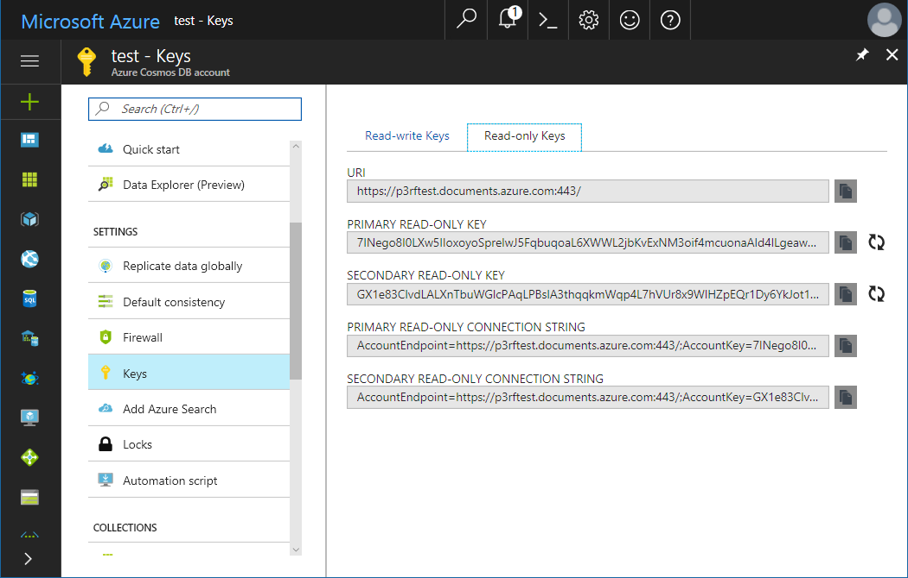
Authorization: Read-Only Keys
In addition to the 2 master keys for the Cosmos DB account, there are 2 read-only keys. These read-only keys will only allow Read operations on the account.
View your Read-only Keys from your Cosmos DB Account blade
Copy yours Uri + Read-only Keys from the Keys panel
Regenerate yours Read-only Keys from the Keys panel

Slide 28
Authorization: Resource Tokens
Resource Tokens all limited time access to resources such as documents, collections, and other key controlled resources.
Limited time access (default 4 hours)
Ability to associate labels with resources to scope the token.
Generated by the service
Best practice is to use an Azure Function to control via AAD who can generate a token. Pattern + video on Channel9.
77339876
Notes:
You can use a resource token (by creating Cosmos DB users and permissions) when you want to provide access to resources in your Cosmos DB account to a client that cannot be trusted with the master key.

Slide 29
Authorization: Create Your Own Roles
{
"Name": "Azure Cosmos Collection and Key Management",
"Id": "fa63e82d-7fa4-4e33-bfe5-295951d2e6a7",
"IsCustom": true,
"Description": "Use to give collection and data permisssions.",
"Actions": [
"Microsoft.DocumentDB/databaseAccounts/apis/databases/containers/*",
"Microsoft.DocumentDB/databaseAccounts/listKeys/action"
],
"NotActions": [],
"DataActions": [],
"NotDataActions": [],
"AssignableScopes": [
"/subscriptions/33ffd99e-b11a-56e8-8104-8c3736853ef7"
]
}
Granular AAD Actions unded the Microsoft.DocumentDB namespace to control exactly what you want developers and applications to access.
Ability to limit database and container opertions like create and delete to only ARM based access. This creates the opportunity for data access only permissions.
Control vNET
Control Firewall
Access Monitoring and Metrics
Create Database
Create Collection
Set Indexing Policy
Set RU's
Run Query
Read and Write Document
Control plane
AAD RBAC/IAM
Data plane
Key and Resource Token
Create the custom Azure Active Directory role
Notes:
In some scenarios, you may want to restrict some users of your organization to perform data operations (that is CRUD requests and queries) only. This is typically the case for developers who don't need to create or delete resources, or change the provisioned throughput of the containers they are working on.
You can restrict the access by creating a custom Azure Active Directory role for the users whom you want to restrict access. The custom Active Directory role should have fine-grained access level to operations using Azure Cosmos DB's granular actions. https://docs.microsoft.com/en-us/azure/cosmos-db/how-to-restrict-user-data#create-the-custom-azure-active-directory-role

Slide 30
Azure Cosmos DB Security: Encryption

Slide 31





Azure Cosmos DB Encryption
Service Managed Keys
(GA)
Encryption by the service using the Service Managed Keys.
Key rotations and servicing fully managed by the service.
Independent implementation from Customer Managed Keys.
First layer of protection is always enabled.
Customer Managed Keys
(GA)
Encryption by the service using the Customer Managed Key
Key rotations are the responsibility of the customer.
Customer Key resides in Azure Key Vault
Second layer of protection (ie double encryption)
Client Side Encryption
(GA)
Encryption before transit
Full control by the developer of keys and storage of keys
One key per document (row)
Select terms (columns) to encrypt
Can be combined with Customer Managed Keys and Service Managed Keys.
Notes:
Data stored in your Azure Cosmos account is automatically and seamlessly encrypted with keys managed by Microsoft (service-managed keys). Optionally, you can choose to add a second layer of encryption with keys you manage (customer-managed keys).
You must store customer-managed keys in Azure Key Vault and provide a key for each Azure Cosmos account that is enabled with customer-managed keys. This key is an account-level key, is used to encrypt all the data stored in that account.
All the data stored in your Azure Cosmos account is encrypted with the customer-managed keys, except for the following metadata:
The names of your Azure Cosmos DB accounts, databases, and containers
The names of your stored procedures
The property paths declared in your indexing policies
The values of your containers' partition keys

Slide 32
Encryption At Rest
Layered
Encryption
Encryption at rest with
Customer Managed Keys
Encryption at rest with Service Managed Keys
User
Data
Notes:
Encryption at rest is a phrase that commonly refers to the encryption of data on nonvolatile storage devices, such as solid state drives (SSDs) and hard disk drives (HDDs). Cosmos DB stores its primary databases on SSDs. Its media attachments and backups are stored in Azure Blob storage, which is generally backed up by HDDs.
With the release of encryption at rest for Cosmos DB, all your databases, media attachments, and backups are encrypted.
Your data is now encrypted in transit (over the network) and at rest (nonvolatile storage), giving you end-to-end encryption. Cosmos DB stores its primary databases on SSDs. Its media attachments and backups are stored in Azure Blob storage, which is generally backed up by HDDs
Encryption at rest is "on" by default. There are no controls to turn it off or on. Azure Cosmos DB uses AES-256 encryption on all regions where the account is running
Periodically, data is read from the secure storage and backed up to the Azure Encrypted Blob Store

Slide 33
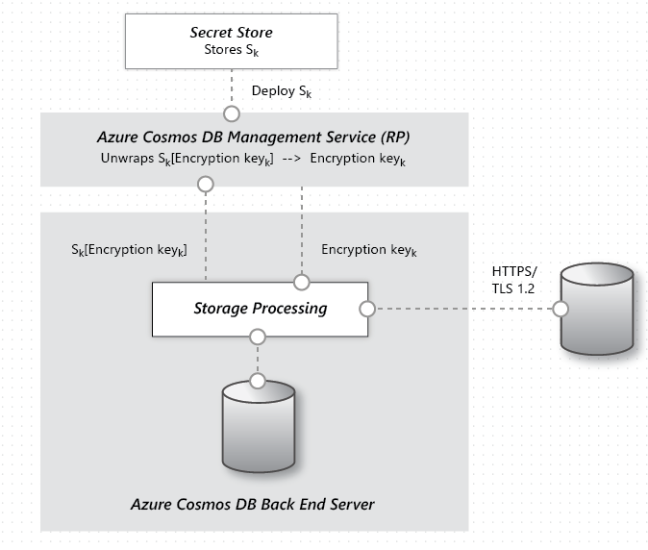
Layer 1: Encryption At Rest With Service Managed Keys
All data in Cosmos DB is encrypted at rest.
There are no user controls to turn it on or off.
Present in all regions with a minimum of FIPS-140 required AES-128.
All regions running AES-256.
Data encryption in Azure Cosmos DB
Notes:
Encryption at rest is implemented by using a number of security technologies, including secure key storage systems, encrypted networks, and cryptographic APIs.
Systems that decrypt and process data have to communicate with systems that manage keys. The diagram shows how storage of encrypted data and the management of keys is separated.
The basic flow of a user request is as follows:
The user database account is made ready, and storage keys are retrieved via a request to the Management Service Resource Provider.
A user creates a connection to Cosmos DB via HTTPS/secure transport. (The SDKs abstract the details.)
The user sends a JSON document to be stored over the previously created secure connection.
The JSON document is indexed unless the user has turned off indexing.
Both the JSON document and index data are written to secure storage.
Periodically, data is read from the secure storage and backed up to the Azure Encrypted Blob Store.

Slide 34


Layer 2: Encryption At Rest With Customer Managed Keys
Enable on New Account
User
AKV
PS C:\> $MyAccountLocation = "centraluseuap"
PS C:\> $MyAzureCosmosDBAccountName = "mybyokaccount"
PS C:\> $MyResourceGroupName = "mybyokgroup"
PS C:\> $RegionalLocations = @(
@{ "locationName" = "Central US EUAP"; "failoverPriority" = 0 },
@{ "locationName" = "EAST US2 EUAP"; "failoverPriority" = 1 } )
PS C:\> $consistencyPolicy = @{
"defaultConsistencyLevel" = "BoundedStaleness";
"maxIntervalInSeconds" = 300;
"maxStalenessPrefix" = 100000; }
PS C:\> $CosmosDBProperties = @{
"databaseAccountOfferType" = "Standard";
"locations" = $RegionalLocations;
"consistencyPolicy" = $consistencyPolicy;
"enableMultipleWriteLocations" = "false";
"keyVaultKeyUri" =
"https://yourbyokvault.vault.azure.net/keys/yourbyokkey"; }
PS C:\> New-AzResource –ResourceType "Microsoft.DocumentDb/databaseAccounts”\
-ApiVersion "2019-12-12” \
-ResourceGroupName $MyResourceGroupName\
-Location $MyAccountLocation\
-Name $MyAzureCosmosDBAccountName \
-Properties $CosmosDBProperties -Force
1. Grant Access
to Azure Cosmos DB
Global Identity
Wrap/Unwap Requests
2. Enable BYOK with
AKV URI to KEY
User Code
And Services
User
Azure Cosmos DB
Configure customer-managed keys for your Azure Cosmos account with Azure Key Vault
Notes:
You must store customer-managed keys in Azure Key Vault and provide a key for each Azure Cosmos account that is enabled with customer-managed keys. This key is an account-level key, is used to encrypt all the data stored in that account.
All the data stored in your Azure Cosmos account is encrypted with the customer-managed keys, except for the following metadata:
The names of your Azure Cosmos DB accounts, databases, and containers
The names of your stored procedures
The property paths declared in your indexing policies
The values of your containers' partition keys
Azure Cosmos DB takes regular and automatic backups of the data stored in your account. This operation backs up the encrypted data. To use the restored backup, the encryption key that you used at the time of the backup is required. This means that no revocation was made and the version of the key that was used at the time of the backup will still be enabled.
Key revocation is done by disabling the latest version of the key. Alternatively, to revoke all keys from an Azure Key Vault instance, you can delete the access policy granted to the Azure Cosmos DB principal. The only operation possible when the encryption key has been revoked is account deletion.
To account for the additional compute load that is required to manage data encryption and decryption with customer-managed keys, all operations executed against the Azure Cosmos account consume a 25 percent increase in Request Units.
See here for detail of Configure customer-managed keys for your Azure Cosmos account with Azure Key Vault

Slide 35

Encryption At Rest With Customer Managed Keys
Encryption at rest with self-managed keys in Azure Key Vault
Keys control who has access to the data.
Once key access is removed Cosmos DB stop all processing, purges all access, and waits for access to be restored to access data.

Slide 36
Azure Cosmos DB Security via Diagnostics

Slide 37
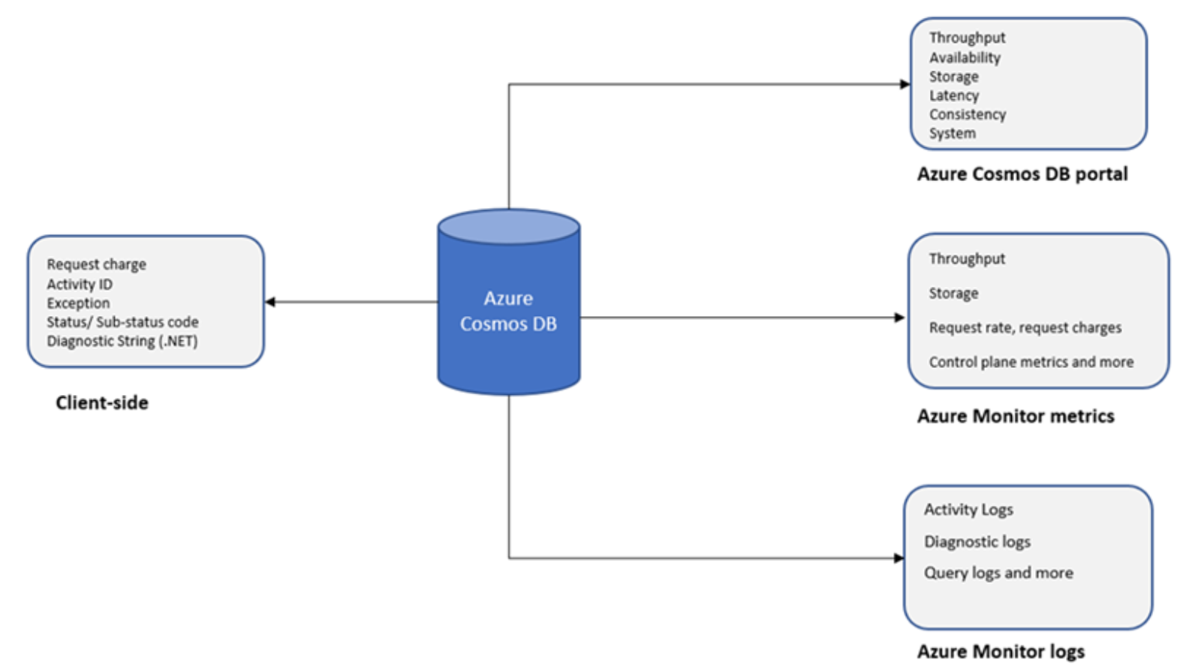
Cosmos DB Monitoring
Server-Side Monitoring
Azure Cosmos DB Portal
Azure Monitor (Metrics)
Azure Monitor (diagnostic logs)
Programmatically with SDKs
Client-Side Monitoring
Capture server response
Use APIM
Notes:
You can monitor your data with client-side and server-side metrics.
When using server-side metrics, you can monitor the data stored in Azure Cosmos DB with the following options:
Monitor from Azure Cosmos DB portal:
Monitor with metrics in Azure monitor:
Monitor with diagnostic logs in Azure Monitor
Monitor programmatically with SDKs: You can monitor your Azure Cosmos account programmatically by using the .NET, Java, Python, Node.js SDKs, and the headers in REST API.
When using Azure Cosmos DB, at the client-side you can collect the details for request charge, activity ID, exception/stack trace information, HTTP status/sub-status code, diagnostic string to debug any issue that might occur. This information is also required if you need to reach out to the Azure Cosmos DB support team.

Slide 38

Monitoring for Attacks
Cosmos DB offers multiple ways to monitor your data:
Azure Audit Logging – Monitor account access.
Azure Monitoring – All user events. Even supports Full Text Query Logging.
Azure Metrics – Review 404’s in the metrics dashboard.
Custom Log Requests

Slide 39
Monitoring for Attacks: Telemetry Collection
Activity Log
IAM (RBAC)
Firewalls
vNETs
Key Access
Diagnostics Monitoring Logs
Create Collection
Offers
Indexing Policies
Read / Insert / … Documents
Metrics
401 – Unauthorized
403 – Access Denied
404 – Not Found

Slide 40
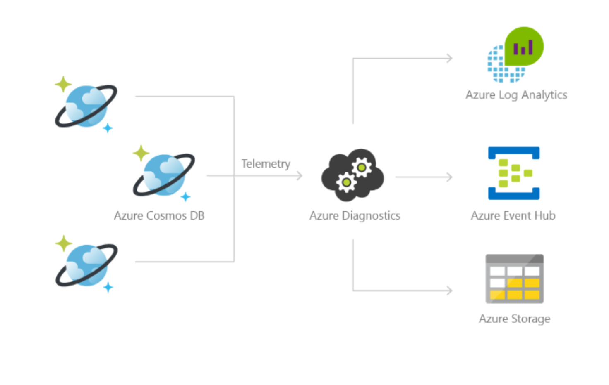
Monitoring for Attacks: Diagnostics

Slide 41
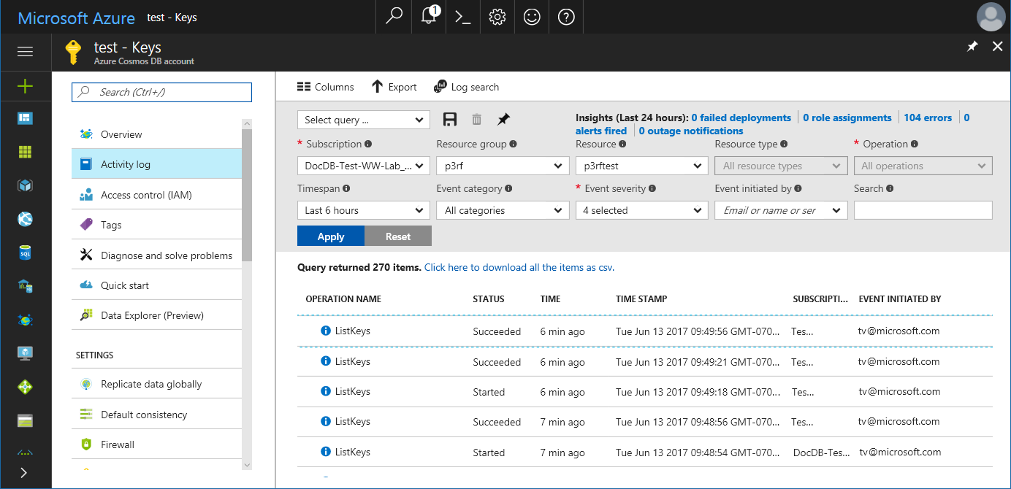
Monitoring for Attacks: Audit Logging
Through audit logging/activity logs, you can view what operations were taken on your resources, who initiated the operation, when the operation occurred, the status of the operation, and much more.
Configure to view logs for Cosmos DB account changes
View who is accessing your keys and making changes to the account
View logging that contains ip address, timestamps, usernames, etc.

Slide 42
Links and Resources

Slide 43
Overall Technical Content
One stop place : https://gotcosmos.com/ (revamping- in progress)
Others:
Workshops & Slideware: https://azurecosmosdb.github.io/CosmosDBWorkshops/#slides
Cosmos DB Blog : https://devblogs.microsoft.com/cosmosdb/
Main Documentation: https://docs.microsoft.com/en-us/azure/cosmos-db/
Cosmos DB Youtube Channel : https://www.youtube.com/azurecosmosdb
MS Learn: https://docs.microsoft.com/en-us/learn/paths/work-with-nosql-data-in-azure-cosmos-db/
Pluralsight courses (free MS FTE access): https://microsoft.sharepoint.com/_layouts/15/search.aspx/?q=pluralsight
Channel 9 events (Build, Ignite) : https://channel9.msdn.com/
Twitter : @AzureCosmosDB ; #AzureCosmosDB , #CosmosDB
Coming Soon:
Partner dedicated 8-part, self paced virtual workshop series

Slide 44
Azure Cosmos DB Security
Database security - Azure Cosmos DB | Microsoft Docs for overall security principals
Azure security baseline for Azure Cosmos DB | Microsoft Docs is the security baseline principals that partners should keep in mind as best practices
Learn how to secure access to data in Azure Cosmos DB | Microsoft Docs for Data Plane access options
Use client-side encryption with Always Encrypted for Azure Cosmos DB | Microsoft Docs is in preview current for client side encryption
Recommended Actions
Schedule a regular rotation and regeneration of your primary and secondary keys.
As a standard security best practice, consider using the Azure Cosmos DB firewall and virtual network integration to control the access to your accounts at the network level.
If you are using the Azure Cosmos DB Core (SQL) API, consider using the Azure Cosmos DB role-based access control (RBAC) to authenticate your database operations with Azure Active Directory instead of primary/secondary keys. With RBAC, you have the option to completely disable your account's primary/secondary keys.
For a complete overview of the security controls available on Azure Cosmos DB check the security baseline link above

Slide 45
Q & A

Slide 46






Platinum Partner
Gold Partner
Silver Partner

